Slide 1
BIOE 437 / BIOE 537 Computational Systems Biology Lecture 4: Reaction Networks as Dynamical Systems
Joseph L. Hellerstein*
Herbert Sauro**
*eScience Institute, Computer Science & Engineering
**BioEngineering
Notes:
Diverse students. Some with bio-backgrounds; some without. Some with CS background; some with very limited. Two separate courses combined because of a substantial shared curriculum.

Slide 2
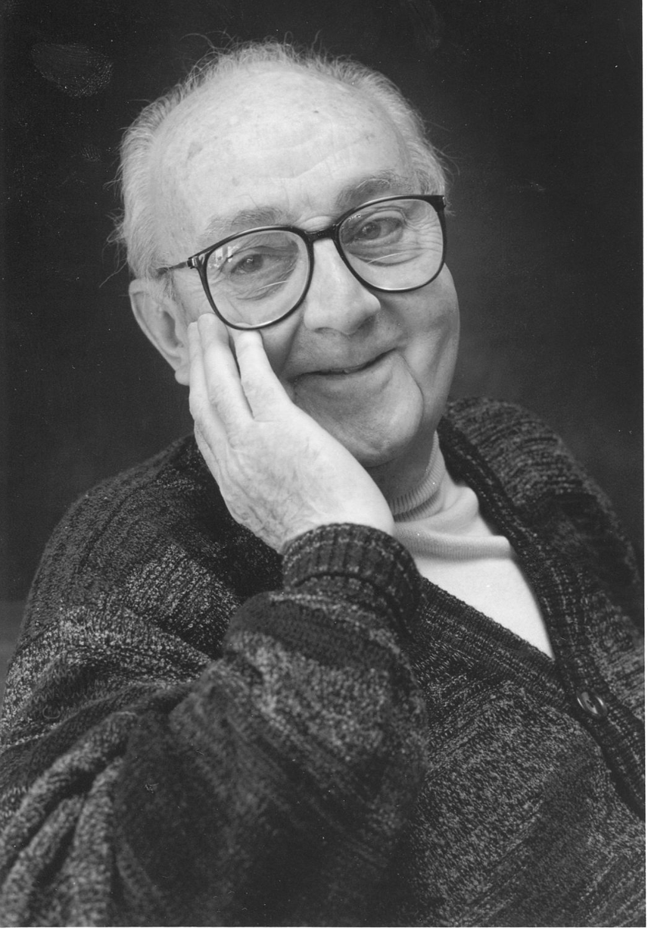
G.P.E. Box (Famous Statistician)
All models are wrong.
But some models are useful.

Slide 3
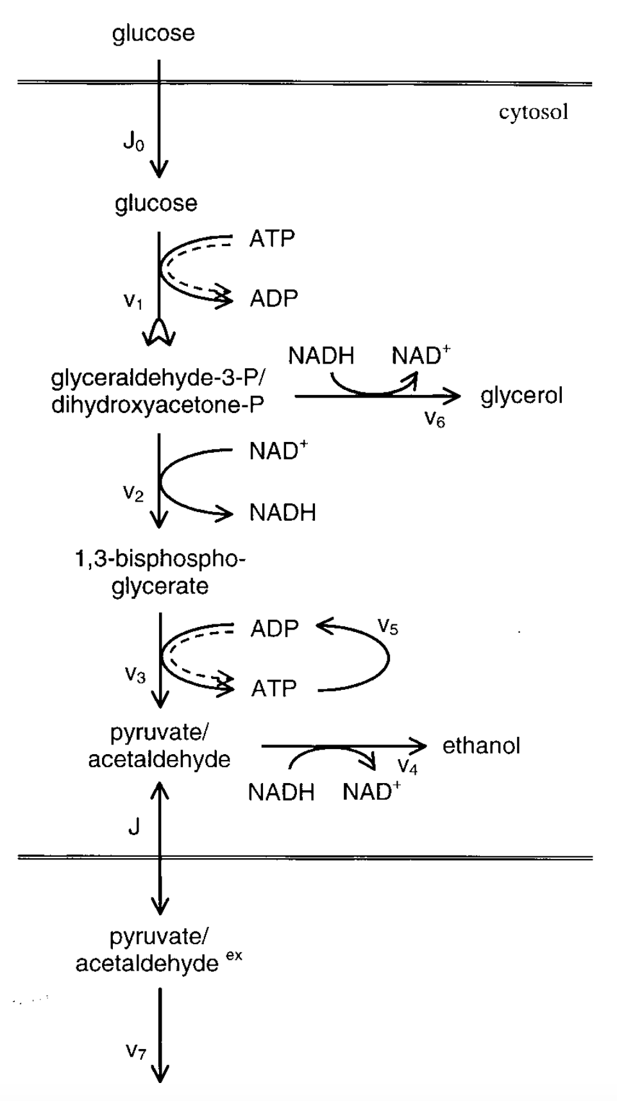
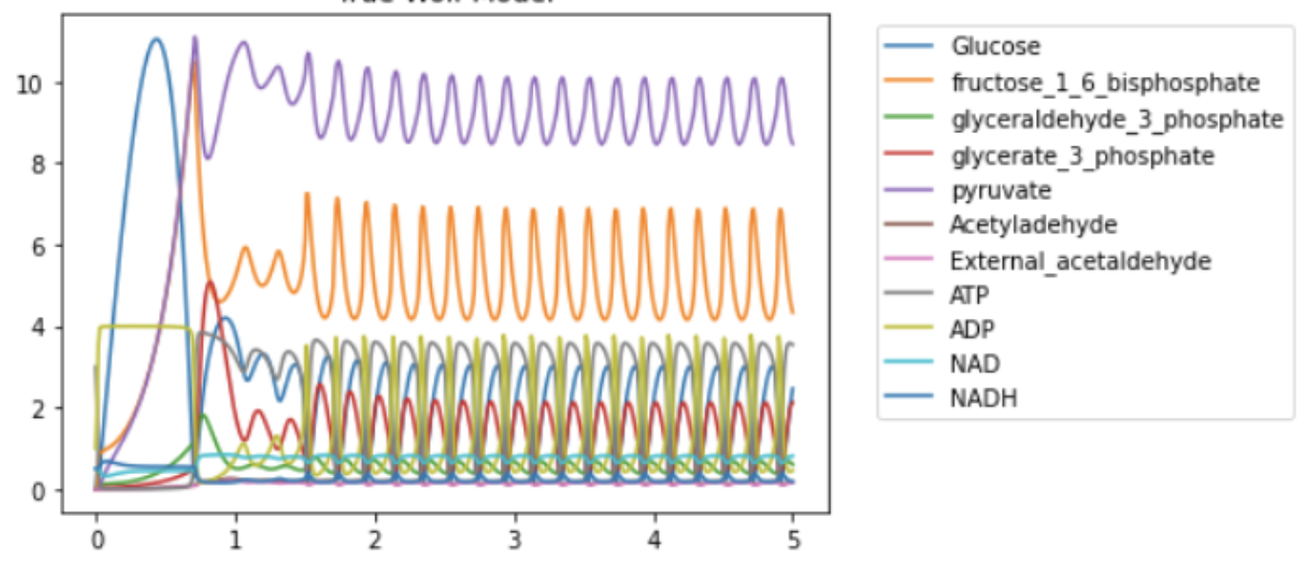
Glycolytic Oscillations in Yeast*
Reaction Network: Interactions between a collection of chemical species.
*Wolf, J. of Biochem., 2000.

Slide 4
Dynamical Systems
A system of ordinary differential equations (ODEs), especially non-linear differential equations.
Examples include the mathematical models that describe: (a) the swinging of a clock pendulum, (b) the flow of water in a pipe, and (c) the number of fish each springtime in a lake.
Reaction networks are dynamical systems.

Slide 5
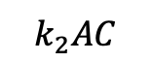
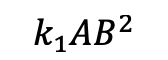
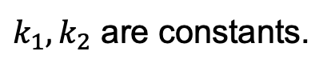
Reaction Networks
A reaction has:
reactants
products
kinetic law
kinetic
law
$$k_{2}AC$$
product
A
R2
2
D
reactant
$$k_{1}AB^{2}$$
R1
C
B
$k_{1},k_{2}$ are constants.
2
R1: A + 2 B -> C; K1*A*B*B
R2: A + C -> 2 D; K2*A*C
A reaction network is a collection of reactions.

Slide 6
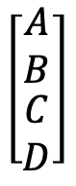
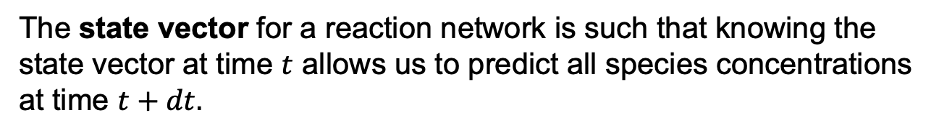
State Vector for A Reaction Network
The state vector for a reaction network is such that knowing the state vector at time $t$ allows us to predict all species concentrations at time $t+dt.$
What is the state vector for this reaction network?
R1: A + 2 B -> C; K1*A*B*B
R2: A + C -> 2 D; K2*A*C
$$\left[\begin{matrix}\begin{matrix}A \\ B\end{matrix} \\ \begin{matrix}C \\ D\end{matrix}\end{matrix}\right]$$

Slide 7

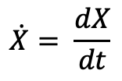
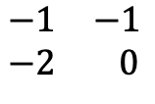
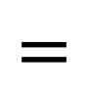
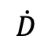
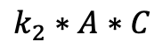
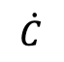
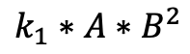
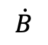
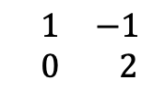
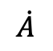
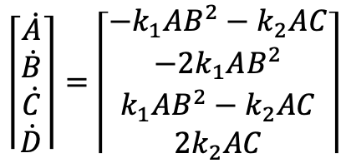
Reaction Network -> Differential Equations
R1: A + 2 B -> C; K1*A*B*B
R2: A + C -> 2 D; K2*A*C
$$\left\lceil \begin{matrix}\begin{matrix}\dot{A} \\ \dot{B}\end{matrix} \\ \begin{matrix}\dot{C} \\ \dot{D}\end{matrix}\end{matrix}\right\rceil =\left\lceil \begin{matrix}\begin{matrix}−k_{1}AB^{2}−k_{2}AC \\ −{2k}_{1}AB^{2}\end{matrix} \\ \begin{matrix}k_{1}AB^{2}−k_{2}AC \\ 2k_{2}AC\end{matrix}\end{matrix}\right\rceil$$
$$\dot{X}= \frac{dX}{dt}$$
[
]
[
R1
R2
]
$$\dot{A}$$
A
[
]
$$\begin{matrix}−1 & −1 \\ −2 & 0\end{matrix}$$
R1
$$\dot{B}$$
$$=$$
B
$$×$$
$$k_{1}∗A∗B^{2}$$
$$\dot{C}$$
C
$$k_{2}∗A∗C$$
R2
$$\begin{matrix} 1 & −1 \\ 0 & 2\end{matrix}$$
$$\dot{D}$$
D
d(State Vector)
Stoichiometry Matrix
Rate Vector

Slide 8

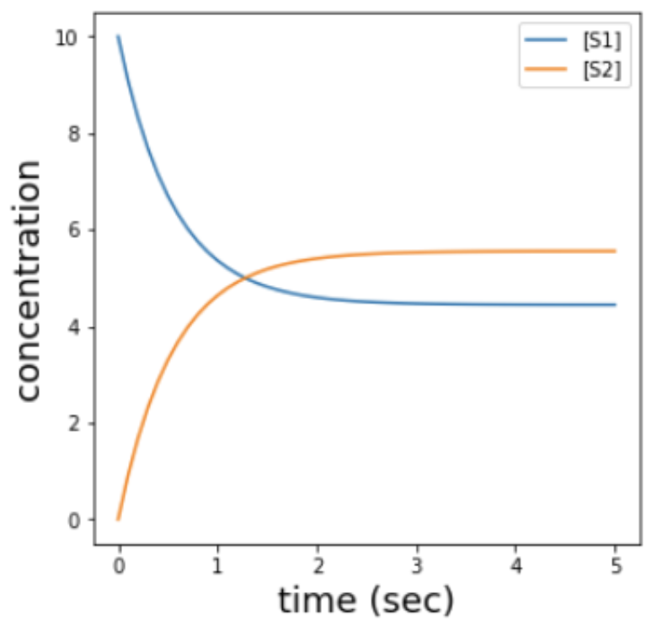
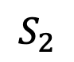
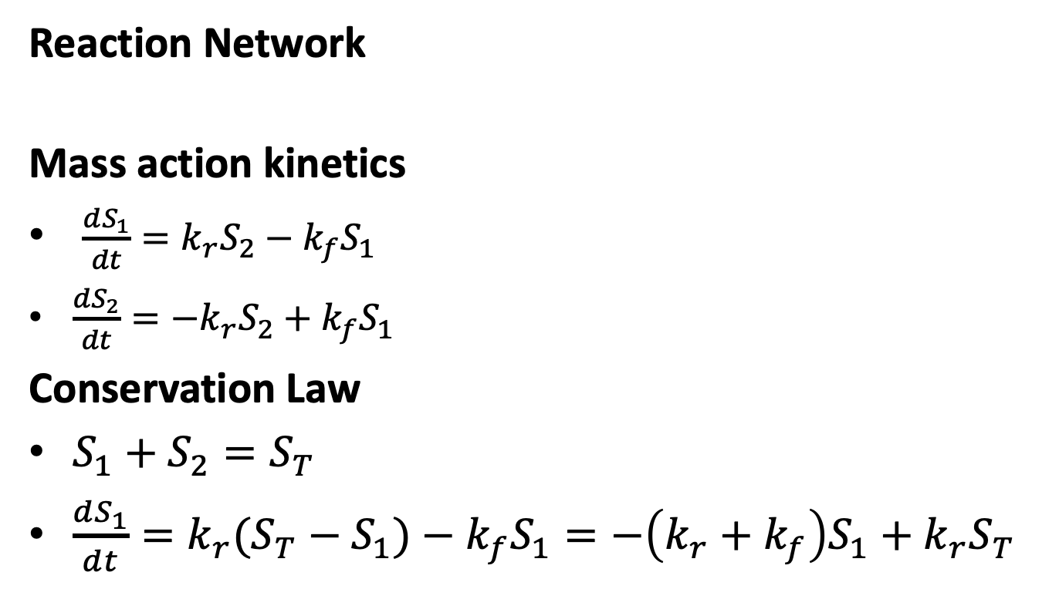
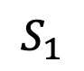
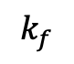
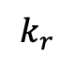
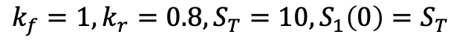
Analysis of a Simple System
Reaction Network
Mass action kinetics
$\frac{dS_{1}}{dt}=k_{r}S_{2}−k_{f}S_{1}$
$\frac{dS_{2}}{dt}={−k}_{r}S_{2}+k_{f}S_{1}$
Conservation Law
$S_{1}+S_{2}=S_{T}$
$\frac{dS_{1}}{dt}=k_{r}{(S_{T}−S}_{1})−k_{f}S_{1}=−\left(k_{r}+k_{f}\right)S_{1}+k_{r}S_{T}$
$$k_{f}$$
$$k_{f}=1,k_{r}=0.8,S_{T}=10,S_{1}\left(0\right)=S_{T}$$
$$S_{1}$$
$$S_{2}$$
$$k_{r}$$
Notes:
Even though there are 2 species, this is really a one dimensional system.

Slide 9
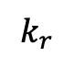
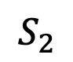
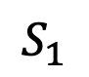
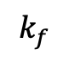
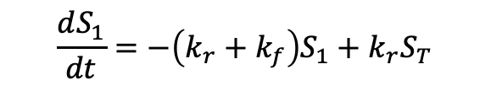
Observations About This System
$$k_{f}$$
$$\frac{dS_{1}}{dt}=−\left(k_{r}+k_{f}\right)S_{1}+k_{r}S_{T}$$
$$S_{1}$$
$$S_{2}$$
$$k_{r}$$
Although there are two chemical species, this is a 1-dimensional system.
”Autonomous system” – dynamics are not a explicit function of time.
There exists a stable steady state.
The system is linear in the state variable.
Notes:
Why is it sufficient to consider just S1?
Why is this system linear?

Slide 10
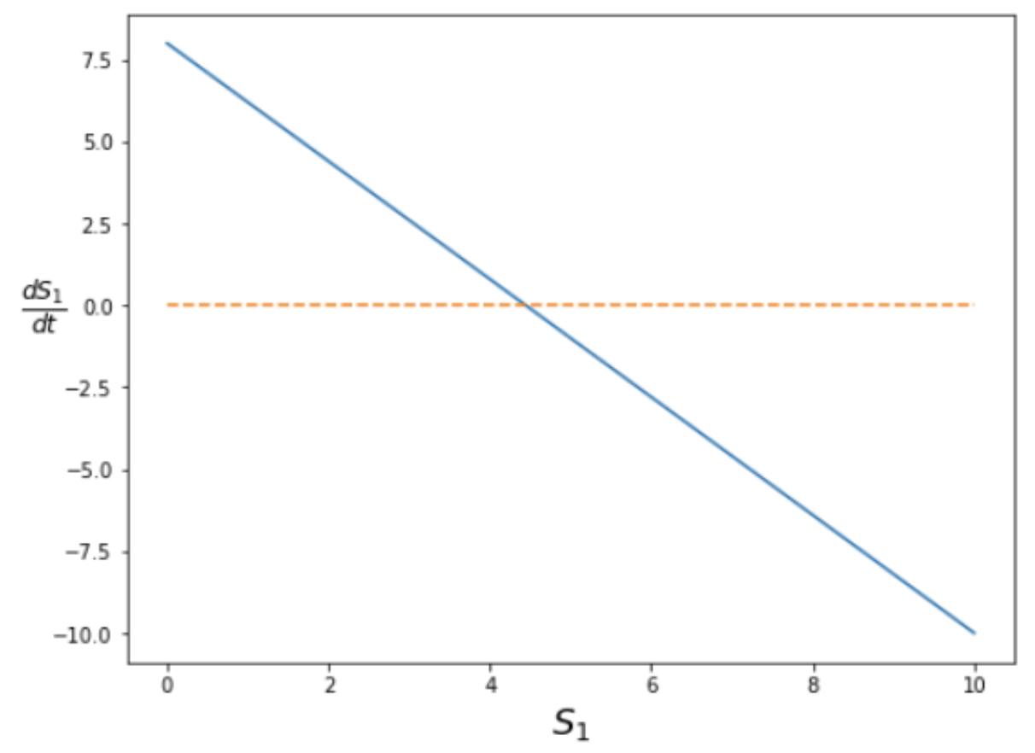
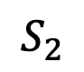
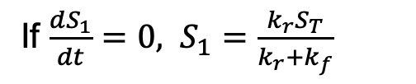
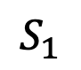
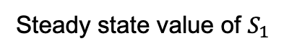
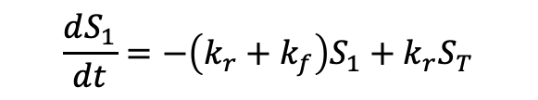
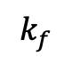
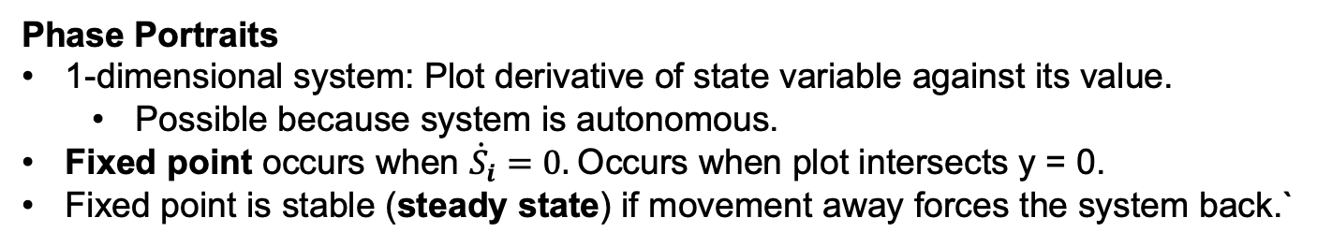
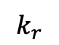
Visualizations and Fixed Points
$$k_{f}$$
$$\frac{dS_{1}}{dt}=−\left(k_{r}+k_{f}\right)S_{1}+k_{r}S_{T}$$
$$S_{1}$$
$$S_{2}$$
If $\frac{dS_{1}}{dt}=0, S_{1}=\frac{k_{r}S_{T}}{k_{r}+k_{f}}$
$$k_{r}$$
Steady state value of $S_{1}$
Phase Portraits
1-dimensional system: Plot derivative of state variable against its value.
Possible because system is autonomous.
Fixed point occurs when ${\dot{S}}_{i}=0.$Occurs when plot intersects y = 0.
Fixed point is stable (steady state) if movement away forces the system back.`
Notes:
Can we be anywhere in the 1-d phase plane? No, only those points specified by the differential equation.
What happens as we move from the fixed point in this example?

Slide 11
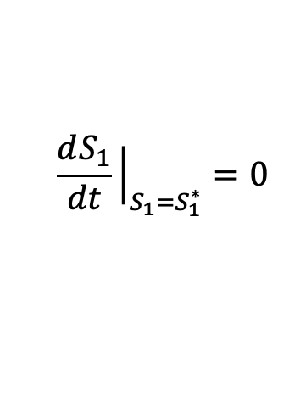

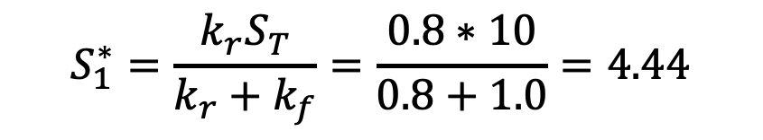
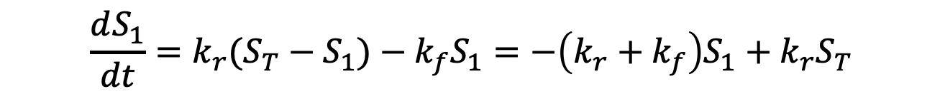
Calculating Fixed Points
$$\frac{dS_{1}}{dt}=k_{r}{(S_{T}−S}_{1})−k_{f}S_{1}=−\left(k_{r}+k_{f}\right)S_{1}+k_{r}S_{T}$$
$$\frac{dS_{1}}{dt}{\left.​\right|}_{S_{1}=S_{1}^{∗}}=0$$
Fixed point when
$$S_{1}^{∗}=\frac{{k_{r}S}_{T}}{k_{r}+k_{f}}=\frac{0.8∗10}{0.8+1.0}=4.44$$

Slide 12
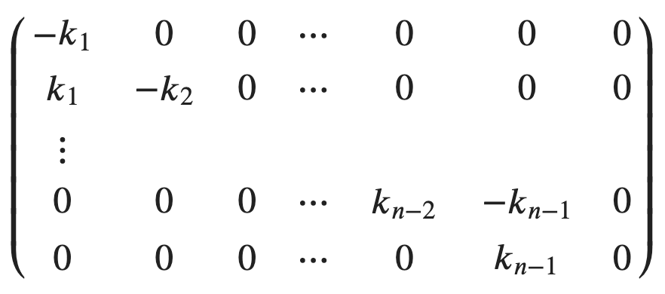
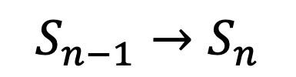
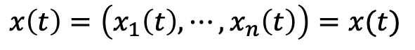
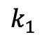
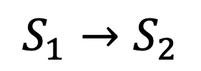
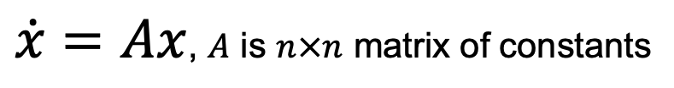
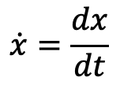

Linear Systems
$$x\left(t\right)=\left(x_{1}\left(t\right),⋯,x_{n}\left(t\right)\right)=x(t)$$
$$\dot{x}=\frac{dx}{dt}$$
$\dot{x}=Ax$, $A$ is $n×n$ matrix of constants
Example of a linear system.
$$k_{1}$$
$$k_{n−1}$$
$$S_{1}→S_{2}$$
$$S_{n−1}→S_{n}$$
Notes:
What are the eigenvalues of this system?
What does it mean to have a 0 eigenvalue?

Slide 13






Solving Linear Systems
Assume $x(t)=ve^{λt}$, where $v$ is $n×1$
So, $\dot{x}=Ax$
$$λve^{λt}=Ave^{λt}$$
$$λv=Av$$
That is, $λ,v$ are eigenvalue, eigenvector pairs of $A$.
Any linear combination of solutions is also a solution.
Key insights
The system is unstable if $Re\left(λ\right)>0$.
The system oscillates if $Im\left(λ\right)≠0.$
The system has a sustained oscillation if Re$\left(λ\right)=0$ and $Im\left(λ\right)≠0$

Slide 14

2 State Variable Phase Portraits
Stable, converges.
Stable, oscillates.
Unstable.
Match the figure with the characteristic.

Slide 15





Fixed Points for 2-d Linear Systems
Linear systems can have several types of fixed points depending on the eigenvalues of A.
For 2 dimensional systems, fixed points are determined by
$\det{A}=a_{11}a_{22}−a_{12}a_{21}$
$Tr A=a_{11}+a_{22}$
For eigenvalues $λ_{1},λ_{2}$
$\det{A=Δ=λ_{1}λ_{2}}$
$Tr A=τ=λ_{1}+λ_{2}$
Note that
$detA, Tr A$ are always real
$Im\left(λ\right)≠0≡λ_{i}$ are conjugates
Tr
$$Tr (τ)$$
$$τ^{2}=4Δ$$
Det ($Δ)$
Notes:
Where is system stable?
Boundary conditions mean that linearizaiton of nonlinear system won’t work

Slide 16

Nonlinear Models
Where do nonlinear models arise in biochemical systems?
$A+B\underset{→}{k}C$
With mass action kinetics, reaction rate is $k$
Kinetics law: $kAB$
Enzyme kinetics
Positive feedback
And much, much more

Slide 17

Example of Nonlinear Kinetics Yeast adaptation to glucose scarcity
Glucose | Lactose | lac Operon Transcription
+ | - | No adaptation
+ | + | Low adaptation
- | - | No adaptation
- | + | Strong adaptation

Slide 18



Modeling the lac Operon
I_{ext}
Model
P
I_{int}
I_{ext} = external inducer (lactose)
I_{int} = internal inducer
P = permease
*Vilar et al., 2003. Journal of Cell Biology.
Qualitative dynamics
I_{int} increases with the product P*(I_{ext}- I_{int}) and degrades in proportion with I_{int}.
P increases in proportion to I_{int} and degrades in proportion to P’s concentration.
The following has the correct qualitative effect:
$$\frac{dI_{int}}{dt}=a\left(I_{ext}−I_{int}\right)P−bI_{int}$$
$$\frac{dP}{dt}=cI_{int}−eP$$
Notes:
1. Why is this model nonlinear?
2. Almost all species in a reaction network contain a degradation term. Why biologically? What are the implications if they don’t?
Is this a linear system?
3. If I_ext is constant, what are the state variables?

Slide 19








Fixed Points in lac operon Model
lac operon model
$$\frac{dI_{int}}{dt}=a\left(I_{ext}−I_{int}\right)P−bI_{int}$$
$$\frac{dP}{dt}=cI_{int}−eP$$
Set derivatives to 0
$$0=a\left(I_{ext}−I_{int}\right)P−bI_{int}$$
$$0=cI_{int}−eP$$
Solving
$${I_{int}^{∗}=I}_{ext}−\frac{be}{ac}$$
$$P^{∗}=\frac{I_{ext}ac−be}{ae}$$
Example
$$a=1, b=0.1, c=1, e=0.5$$
$$I_{ext}$$ | $$I_{int}^{∗}$$ | $$P^{∗}$$
3.0 | 2.96 | 5.9
1.5 | 1.45 | 2.9
Notes:
Changing the external concentration of the inducer changes the fixed point.

Slide 20


Characterizing Fixed Point(s)
Characterizing means classifying the type
Stable? Unstable? Saddle? Oscillatory?
Approach: Linearization
Construct linear approximations of the differential equations at the fixed point
Calculate the trace and determinant of the A matrix
Use results from linear models to classify the fixed point
Works for Stable node, unstable node, saddle
Doesn’t help with center (oscillation)
Tr
$$Tr (τ)$$
$$τ^{2}=4Δ$$
Det ($Δ)$

Slide 21







Linearization: 1
$$\frac{dI_{int}}{dt}=f\left(I_{int},P\right)=a\left(I_{ext}−I_{int}\right)P−bI_{int}$$
$$\frac{dP}{dt}=g\left(I_{int},P\right)=cI_{int}−eP$$
$$\left(\begin{matrix}\frac{dI_{int}}{dt} \\ \frac{dP}{dt}\end{matrix}\right)≈A\left(\begin{matrix}I_{int} \\ P\end{matrix}\right)$$
Find a matrix A such that
Taylor series approximation
Jacobian
$$f\left(i_{int},P\right)≈\frac{df}{dI_{int}}dI_{int}+\frac{df}{dP}dP$$
$≡{\left(\begin{matrix}\frac{df}{dI_{int}} & \frac{df}{dP} \\ \frac{dg}{dI_{int}} & \frac{dg}{dP}\end{matrix}\right)}_{I_{int}^{∗},P^{∗}}$ $\left(\begin{matrix}{dI}_{int} \\ dP\end{matrix}\right)$
$$g(I_{int},P)≈\frac{dg}{dI_{int}}dI_{int}+\frac{dg}{dP}dP$$
$\left(\begin{matrix}\frac{dI_{int}}{dt} \\ \frac{dP}{dt}\end{matrix}\right)=A_{I_{int}^{∗},P^{∗}}\left(\begin{matrix}{dI}_{int} \\ dP\end{matrix}\right)={\left(\begin{matrix}−aP^{∗}−b & a(I_{ext}−I_{int}^{∗}) \\ c & −e\end{matrix}\right)}_{ }$ $\left(\begin{matrix}{dI}_{int} \\ dP\end{matrix}\right)$

Slide 22







Linearization: 2
$${I_{int}^{∗}=I}_{ext}−\frac{be}{ac}$$
$\left(\begin{matrix}\frac{dI_{int}}{dt} \\ \frac{dP}{dt}\end{matrix}\right)=A_{I_{int}^{∗},P^{∗}}\left(\begin{matrix}{dI}_{int} \\ dP\end{matrix}\right)={\left(\begin{matrix}−aP^{∗}−b & a(I_{ext}−I_{int}^{∗} \\ c & −e\end{matrix}\right)}_{ }$ $\left(\begin{matrix}{dI}_{int} \\ dP\end{matrix}\right)$
$$P^{∗}=\frac{I_{ext}ac−be}{ae}$$
Example
$$a=1, b=0.1, c=1, e=0.5$$
Tr
$$Tr (τ)$$
$$I_{ext}$$ | $$I_{int}^{∗}$$ | $$P^{∗}$$
3.0 | 2.96 | 5.9
1.5 | 1.45 | 2.9
$$τ^{2}=4Δ$$
$$A=\left(\begin{matrix}−6.00 & 0.05 \\ 1.00 & −0.5\end{matrix}\right)$$
Det ($Δ)$
$$detA=Δ=2.95, TrA=τ=−6.5$$
$$τ^{2}=42.25, 4Δ=11.8$$
Linearization indicates a stable node!

Slide 23






Phase Portrait For lac Operon Model
$$\frac{dI_{int}}{dt}=a\left(I_{ext}−I_{int}\right)P−bI_{int}$$
$$\frac{dP}{dt}=cI_{int}−eP$$
$$I_{ext}$$ | $$I_{int}^{∗}$$ | $$P^{∗}$$
3.0 | 2.96 | 5.9
1.5 | 1.45 | 2.9
$$a=1, b=0.1, c=1, e=0.5$$

Slide 24
Kinetics in Wolf Model
J0: $External_glucose => Glucose; J0_inputFlux;
J1: Glucose + 2 ATP => fructose_1_6_bisphosphate + 2 ADP; J1_k1*Glucose*ATP*
(1/(1 + (ATP/J1_Ki)^J1_n));
J2: fructose_1_6_bisphosphate => glyceraldehyde_3_phosphate +
glyceraldehyde_3_phosphate; J2_k*fructose_1_6_bisphosphate;
J3: glyceraldehyde_3_phosphate + NADH => NAD + $Glycerol;
J3_k*glyceraldehyde_3_phosphate*NADH;
J4: glyceraldehyde_3_phosphate + ADP + NAD => ATP + glycerate_3_phosphate + NADH;
(J4_kg*J4_kp*glyceraldehyde_3_phosphate*NAD*ADP –
J4_ka*J4_kk*glycerate_3_phosphate*ATP*NADH)/(J4_ka*NADH + J4_kp*ADP);
J5: glycerate_3_phosphate + ADP => ATP + pyruvate; J5_k*glycerate_3_phosphate*ADP
J6: pyruvate => Acetyladehyde; J6_k*pyruvate;
J7: Acetyladehyde + NADH => NAD + $ethanol; J7_k*Acetyladehyde*NADH
J8: Acetyladehyde => External_acetaldehyde; J8_k1*Acetyladehyde –
J8_k2*External_acetaldehyde;
J9: ATP => ADP; J9_k*ATP;
J10: External_acetaldehyde => $Sink; J10_k*External_acetaldehyde;

Slide 25




Effect of Simulation Parameters (Wolf)
J1_k1
J0_inputFlux = 50; J1_k1 = 550; J1_Ki = 1; J1_n = 4; J2_k = 9.8; J3_k = 85.7; J4_kg = 323.8; J4_kp = 76411.1; J4_ka = 57823.1; J4_kk = 23.7; J5_k = 80; J6_k = 9.7; J7_k = 2000; J8_k1 = 375; J8_k2 = 375; J9_k = 28; J10_k = 80;
550
600
700
800
Notes:
J1_k1 appears in only one reaction but it has a major impact of the presence of oscillations. Understanding this requires a dynamical systems analysis to see the type of fixed points and how they change with parameters.

Slide 26



Bifurcations and Bifurcation Plots
A bifurcation occurs when the change in the value of a parameter results in qualitatively different behavior, such as transitions between a stable node and a limit cycle.
Wolf, J. of Biochem., 2000.

Slide 27

Stochastic Models
Motivation
Address situations where there are few molecules (e.g., low expression rates)

Slide 28




Markov Model Core Concepts
States: Specifies variable values that completely characterize how the system behaves
Transition rates: Probability per time unit of the system moving from state to state
State 1
$$r_{11}$$
State Diagram
$$r_{1N}$$
State N
$$r_{N,1}$$
$$r_{NN}$$

Slide 29




Markov Model Example:
$$A→B$$
State: Number of molecules of A (or B)
Transition: Change in the number of molecules of A as a result of a reaction
Each molecule of A reacts at a constant rate
$$λ$$
$$Nλ$$
$$λ$$
N
N-1
0
Notes:
Why are there only arrows between adjacent states? Why is the last array lambda?

Slide 30


Deterministic vs. Stochastic Model
Deterministic
(Differential Equation)
Stochastic

Slide 31


Effect of the Number of Molecules
100
10
1000

Slide 32






Markov Model Example:
$$A↔B$$
States?
Molecules of A
N is the sum of the molecules of A, B
State Diagram?
$$Nλ_{A}$$
$$2λ_{A}$$
$$Nλ_{B}$$
N
N-1
1
0
$$λ_{B}$$
$$λ_{A}$$
Notes:
Why are there only arrows between adjacent states? Why is the last array lambda?
B arrows go to the left; A arrows go to the right.

Slide 33
Key Concepts
ODE (deterministic) models
From reactions to differential equations
Solving linear ODEs
Calculating fixed points
Types of fixed points
Phase portraits
Stochastic models
How probabilities are obtained from states and transition rates

Slide 34
BACKUP

Slide 35
Why differential equations
From reactions to differential equations
Single variable, linear, homogeneous
Stability? Speed of dynamics?
Multiple variables, linear
Stability? Speed of dynamics? Oscillations
Non-linear
Fixed points

Slide 36






Single Reactant, Linear Pathway is a Linear (With Mass Action Kinetics)
Reaction Network
Differential Equations
$$k_{1}$$
$$\frac{dS_{1}}{dt}=−k_{1}S_{1}$$
$$S_{1}→S_{2}$$
$$k_{n−1}$$
$$\frac{dS_{n−1}}{dt}=k_{n−2}S_{n−2}−k_{n−1}S_{n−1}$$
$$S_{n−1}→S_{n}$$
Notes:
What’s the dimension of this system?
Why is there an n-2 term in the equation for S_{n-1}?
Is the network still linear if the reactions are reversible?
Under what conditions can we, in general, expect that a network will be a linear system using mass action kinetics?

Slide 37



Calculating Fixed Points
$$\frac{dS_{1}}{dt}=k_{r}{(S_{T}−S}_{1})−k_{f}S_{1}=−\left(k_{r}+k_{f}\right)S_{1}+k_{r}S_{T}$$
$$\frac{dS_{1}}{dt}{\left.​\right|}_{S_{1}=S_{1}^{∗}}=0$$
Fixed point when
$$k_{r}S_{2}=k_{f}S_{1}≡\frac{k_{f}}{k_{r}}=\frac{S_{2}}{S_{1}}=K_{eq}$$
$$K_{eq}=\frac{1}{0.8}=1.25$$
$$S_{1}^{∗}=\frac{1}{1+K_{eq}}=0.44$$

